Slide 1




Slide 2

TEST TIME ON MENSURATION
URL: https://forms.gle/mfbX3wNYK5zwsPz66
QR CODE:

Slide 3

TRIGONOMETRY

Slide 4
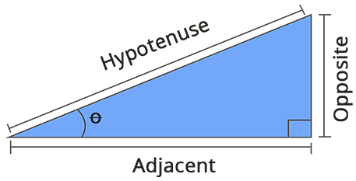
Trigonometry

Slide 5
TRIGONOMETRY
Deals with the study of the relationship between the sides and angles of the right-angle triangle. Hence, it helps to find the missing or unknown angles or sides of a right triangle using the trigonometric formulas, functions or trigonometric identities.
In trigonometry, the angles can be either measured in degrees or radians. Some of the most commonly used trigonometric angles for calculations are 0°, 30°, 45°, 60° and 90°.

Slide 6
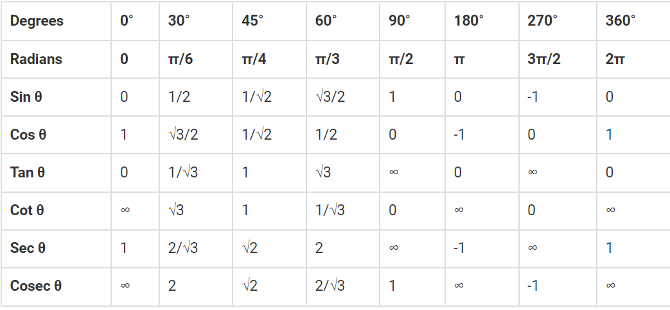
TRIGONOMETRY TABLE

Slide 7
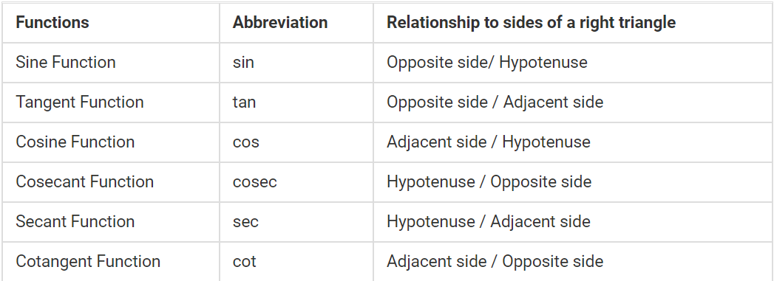
TRIGONOMETRY FUNCTION

Slide 8
Question: 01
An observer 1.6 m tall is 20√3 away from a tower. The angle of elevation from his eye to the top of the tower is 30°. The heights of the tower is:
A] 21.6 m
B] 23.2 m
C] 24.72 m
D] 22.8 m
Answer : A

Slide 9
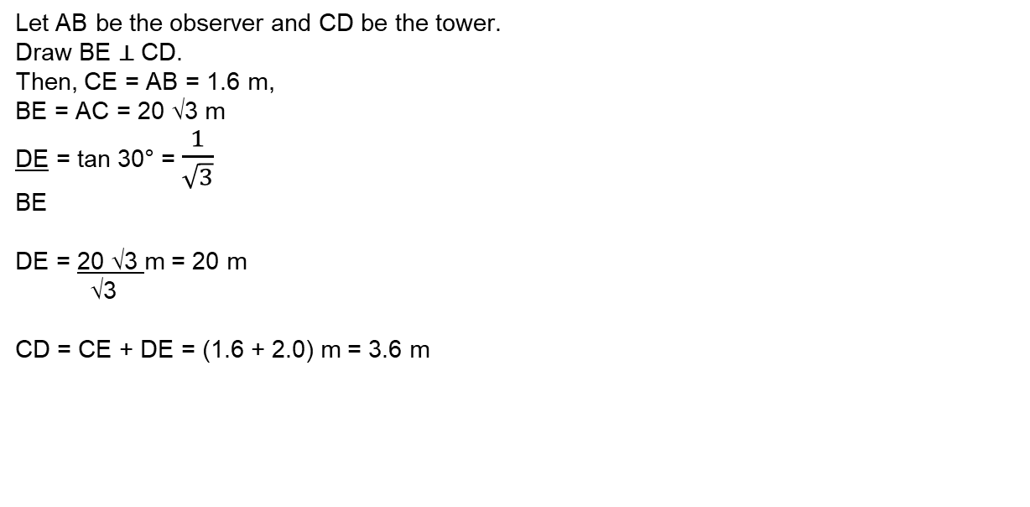
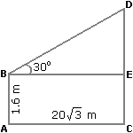
Explanation: 01

Slide 10
Question: 02
A man standing at a point P is watching the top of a tower, which makes an angle of elevation of 30° with the man's eye. The man walks some distance towards the tower to watch its top and the angle of the elevation becomes 60°. What is the distance between the base of the tower and the point P?
A] 4√3 units
B] 8 units
C] 12 units
D] Data inadequate
Answer : D

Slide 11
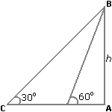
Explanation: 02
One of AB, AD and CD must have given.
So, the data is inadequate.

Slide 12
Question: 03
Two ships are sailing in the sea on the two sides of a lighthouse. The angle of elevation of the top of the lighthouse is observed from the ships are 30° and 45° respectively. If the lighthouse is 100 m high, the distance between the two ships is:
A] 173 m
B] 200 m
C] 273 m
D] 300 m
Answer : C

Slide 13
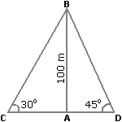
Explanation:03
Let AB be the lighthouse and C and D be the positions of the ships.
Then, AB = 100 m, ACB = 30° and ADB = 45°.
AB/BC = tan 45° = 1/√3
🡺 AC = AB x √3 = 100 √3 m
AB/AD = tan 45° = 1
AD=AB=100 m
CD = AC + AD = 100 √3 + 100
= 100(√3 + 1)
= 273 m

Slide 14
Question: 04
If a sin 45⁰ = b cosec 30⁰, what is the value of a⁴/b⁴ ?
6³
4³
2³
None of the above
Answer : B

Slide 15
Explanation: 04
Given a sin 45⁰ = b cosec 30⁰
So, a/b = cosec 30⁰/ sin 45⁰
a/b = 2/( 1/√2)
a/b = 2√2/1
a⁴/b⁴ = (2√2/1)⁴
a⁴/b⁴ = 64/1
or,
a⁴/b⁴ = 4³

Slide 16
Question: 05
If tan θ + cot θ = 2, then what is the value of tan¹⁰⁰ θ + cot¹⁰⁰ θ ?
1
3
2
None of the above
Answer : C

Slide 17
Explanation: 05
Given tan θ + cot θ = 2
Put θ = 45⁰, above equation will satisfy as,
1 + 1 = 2
So, θ = 45⁰,
= tan¹⁰⁰ 45⁰ + cot¹⁰⁰ 45⁰
= 1¹⁰⁰ + 1¹⁰⁰
= 2

Slide 18
Question: 06
If the value of α + β = 90⁰, and α : β = 2 : 1, then what is the ratio of cos α to cos β ?
1 : 3
√3 : 1
1 : √3
None of the above
Answer : C

Slide 19
Explanation: 06
Given α + β = 90⁰, and α : β = 2 : 1
So, we can say that 2x + x = 90⁰
3x = 90⁰, which give
x = 30⁰
So, α = 2x = 60
β = x = 30
cos α / cos β = cos 60⁰ / cos 30⁰
=> (1/2) / (√3/2)
or, 1/2 * 2/√3
= 1/√3
Or the ratio between cos α : cos β = 1 : √3

Slide 20
Question: 07
Sine rule for a triangle states that
A] a/sin A = b/sin B = c/sin C
B] sin A/a = sin B/b = sin C/c
C] a/sin A + b/sin B + c/sin C
D] 2a/sin A = 2b/sin B = 2c/sin C
Answer : B

Slide 21
Explanation: 07
sin A/a = sin B/b = sin C/c

Slide 22
Question: 08
If θ is said to be an acute angle, and 7 sin2 θ + 3 cos2 θ = 4, then what is the value of
tan θ ?
1
√3
1/√3
None of the above
Answer : C

Slide 23
Explanation: 08
We can directly check the equation by putting values of θ. Let's put θ = 30⁰
7 sin² 30⁰ + 3 cos² 30⁰= 4
Then, 7 * 1/4 + 3 * 3/4 = 4
So, 7/4 + 9/4 = 4
16/4 = 4
Or, 4 = 4 (so, it satisfy the condition)
Now, tan 30⁰ = 1/√3

Slide 24
Question: 09
If tan θ - cot θ = 0, what will be the value of sin θ + cos θ ?
1
√2
1/√2
None of the above
Answer : B

Slide 25
Explanation: 09
Given tan θ - cot θ = 0
Let's put θ = 45⁰ in order to satisfy the above equation
tan 45⁰ - cot 45⁰ = 0
1 - 1 = 0 (equation satisfied with θ = 45⁰)
Now, put θ = 45⁰ in sin θ + cos θ, we will get
= sin 45⁰ + cos 45⁰
= 1/√2 + 1/√2
= √2

Slide 26
Question: 10
If θ is said to be an acute angle, and 4 cos² θ - 1 = 0, then what is the value of tan (θ - 15⁰) ?
1
√2
1/√3
None of the above
Answer : A

Slide 27
Explanation: 10
Given 4 cos² θ - 1 = 0
4 cos² θ = 1
cos² θ = 1/4
cos θ = 1/2
Or, θ = 60⁰
So, tan (θ - 15⁰) = ?
=> tan (60⁰ - 15⁰)
= tan 45⁰
= 1

Slide 28
Question: 11
The number of real solutions of the equation sin ( e^{x} ) = 5^{x} + 5 ^{– x} is
A] 0
B] 1
C] 2
D] Infinite
Answer : A

Slide 29
Explanation: 11
Since 5^{x} + 5^{-x} >= 2
Therefore , we have no solution to the given equation as sin^{x} <= 1

Slide 30
Question: 12
From a point P on a level ground, the angle of elevation of the top tower is 30°. If the tower is 100 m high, the distance of point P from the foot of the tower is
A] 149 m
B] 156 m
C] 173 m
D] 200 m
Answer : C

Slide 31
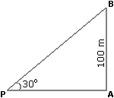
Explanation: 12
Let AB be the tower.
Then, ∠ APB = 30º and AB = 100 m.
AB= tan 30º =1/ √3
AP
AP= (AB x √3) m
= 100√3 m
= (100 x 1.73) m
= 173 m.

Slide 32
Question: 13
A ship is approaching an observation tower. If the time taken by the ship to change the angle of elevation from 30° to 45° is 10 minutes, then find the time the ship will take to cover the remaining distance and reach the observation tower assuming the ship to be travelling at a uniform speed.
A] 15 minutes 20 seconds
B] 13 minutes 40 seconds
C] 16 minutes 40 seconds
D] Cannot be determined
Answer : B

Slide 33
Explanation: 13
Let AB be the observation tower and h be its height.
Also, let the ship be at C when the angle of elevation is 30° and at D when the angle of elevation is 45°.
The time taken by the ship to travel from C to D is 10 minutes and we need to find out the time the ship will take to reach B from D.
tan30 = AB/CB = h/CB = 1/√3
CB = √3*h
tan45 = AB/DB = h/DB = 1
DB = h
CD = CB – DB = (√3h – h) = h(√3 – 1)
Now, as h(√3 – 1) distance is covered in 10 minutes, a distance of h is covered in = 13.66 minutes = 13 minutes 40 seconds

Slide 34
Question: 14
A little boy is flying a kite. The string of the kite makes an angle of 30° with the ground. If the height of the kite is h = 24 m, find the length (in meters) of the string that the boy has used.
A] 48
B] 50
C] 52
D] 54
Answer : A

Slide 35
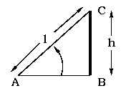
Explanation: 14
If the kite is at C and the boy is at A, then AC = l represents the length of the string and BC = h represents the height of the kite. From the figure, sin A = sin 30º = h / l = 1 / 2. Hence the length of the string used by the little boy is l = 2 h = 2 (24) = 48 m.

Slide 36
Question: 15
A tree breaks due to storm and the broken part bends (without being detached) so that the top of the tree touches the ground making an angle of 30° with it. The distance between the foot of the tree to the point where the top touches the ground is 8 m. Find the height of the tree.
A] 11.57 m
B] 16.24 m
C] 13.86 m
D] 12.34 m
Answer : C

Slide 37
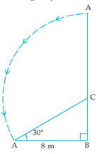
Explanation: 15
Let ACB be the tree. When broken at point C by the storm, let its top A touch the ground so that ∠CAB = 30° and AB = 8 m. From right angled ΔABC, we get
tan 30° = BC/AB ⇒ 1/√3= BC/8m
Also cos 30° = AB/AC => √3/2 = 8 m/AC
AC= 16/√3 m
Therefore, the height of tree = BC+AC = 8/√3 m + 16/√3 m
= 8√3 m
= 13.86 m

Slide 38




THANK YOU
+91 78150 95095
codemithra@ethnus.com
www.codemithra.com

